Slide 1
Year 2 Information PowerPoint

Slide 2
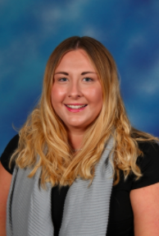
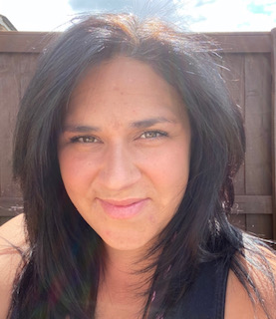
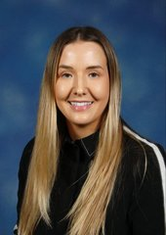
The Year Two Team!
Year Two Oak
Year Two Pear
Mrs Atkinson/Mrs Huston
&
Mrs Ross
Miss Malpass
&
Mrs Hayman

Slide 3
The Year Two Timetable
Snack break - 10:20-10:40am Lunch - 12:25pm – 1:25pm
Your child will have fruit during the day and milk is optional.

Slide 4
What will your child need?
Book bag (no back packs) containing their reading record, reading book and home spelling book.
- Water bottle filled with only water.
- Wellies for Woodland Warriors.
PE kits worn during PE days. Please check your child's timetable in September.
A healthy snack.

Slide 5
Building Learning Power Characters
We teach the children about positive attitudes to learning through the life skills of the Building Learning Power Characters.
Have a Go Hare
Bradley Bat (Listening)
Busy Beaver (resourceful)
Resilient Rhino
Tom Tortoise (reflection)
Team Ant

Slide 6
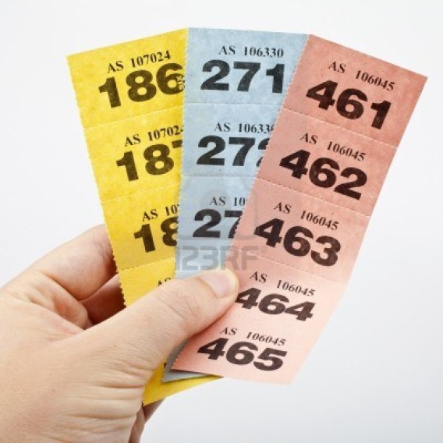
Behaviour Policy

Slide 7
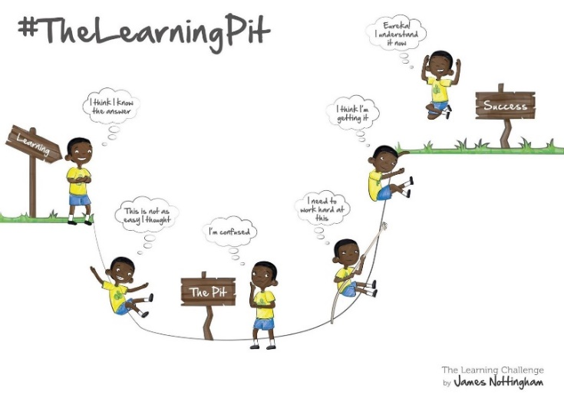
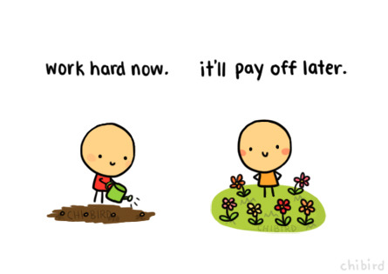
Year Two Expectations
SATS in May 2023:
2 Reading Comprehension Test Papers.
Maths Arithmetic Paper.
Maths Reasoning Paper.
Spelling Test.
Spelling, Punctuation and Grammar Paper.

Slide 8
Reading
Read every night – parents should sign the reading diary
Children will change their own books on a Monday, Wednesday and Friday
On Tuesdays and Thursdays, children are expected to re-visit their book, answer questions on the text and improve fluency.
By the end of Year 2, with age-appropriate books, children can read most words accurately without overt sounding and blending, and sufficiently fluently to allow them to focus on their understanding rather than on decoding individual words. They will also be able to sound out most unfamiliar words accurately, without undue hesitation.

Slide 9
Accelerated Reader
As your children progress through the coloured band books they will eventually be given a login for accelerated reader. As teachers we decide when it is the appropriate time for children to access the accelerated reader programme.
ARI is a computer based programme that helps us as teachers monitor children’s independent reading practice. Your child picks a book at his/her own level and reads it as his/her own pace. When finished, your child takes a short quiz on the computer – passing the quiz is an indication that your child has understood what they have read.
Your child will have access to ARI every morning and throughout the school day.

Slide 10
Examples of Inference Questions
What words make you think that? Why?
How do you feel about………? Why?
Can you explain why………….?
At the end of the story the main character is feeling ……. Does this surprise you?
What does this tell you about what ……….was thinking?
Do you think this is true/untrue? Why do you think this?
What do you think the ………. is thinking? If it were you what would you be thinking?
Predict what you think is going to happen next. Why do you think this?
From what you have read, can you tell me what you feel about….?
Who would you like to meet most in the story? Why?
What is your opinion? What did you like/dislike about the story? Can you find pages in the book to show me?

Slide 11
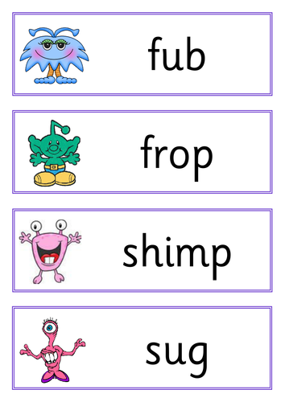
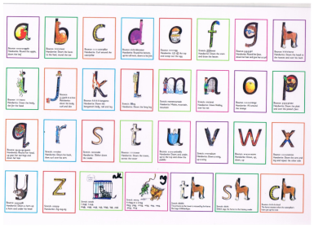
Phonics and Spellings
In the autumn term, we will continue with daily phonics lessons. Throughout the year, children who require phonics support will continue to take part in daily phonics lessons.
Children will be given a half termly spelling sheet with spellings to be learnt for a weekly test. They will continue to have a home/spelling book, the same as they had in Year 1.

Slide 12
Writing in Year 2
Children will have the opportunity to write for a range of different purposes.
They will be encouraged to use the Year 2 key objectives for writing to make the expected standard.
Handwriting and presentation will be a big focus.

Slide 13
Sentence types
A dog went for a walk. a statement
What big eyes you have Grandma! an exclamation
How lovely it is to see you!
Listen to me now! a command
Pour the milk into the bowl.
What time is it? a question

Slide 14
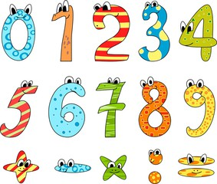
Maths in Year 2
Children will be expected to know the following number facts by the end of Year 2:
Count forwards and backwards in ones from any given number.
Counting forwards and backwards in 2,3,5,10.
Number bonds to 10, 20, 100.
2, 3, 5, 10 times tables.
Please take the time to practise every week.

Slide 15
Maths Continued…
If you are unsure on how to teach your child a method, please speak to your class teacher.
Please ensure that your child forms their numbers correctly and can read and write numbers up to 100 (both words and numerals)

Slide 16
Catholic Life in Year 2
Children will take part in Collective Worship once a week and Mass throughout the term. Your child may be involved in planning and leading these events. Please help your child learn any readings, stories sent home.
Year 2 Prayers:
The Prayer of St. Francis of Assisi
The Rosary
Eternal Rest
Act of Faith
Act of Hope

Slide 17
Home Learning
The home learning policy can be found on our school website.
Home Learning will be given out every Friday and will need to be handed back by the following Thursday.
Children will also have a spelling list sent home half termly just like they did in Year 1, they will be tested once a week.
Late Home Learning will not be marked.
Children should be encouraged to complete their Home Learning independently.
Times tables - the children will be tested every few weeks.
Times Table Rockstars is a great platform to help your children practice their tables at home.
Please feel free to let us know how your children got on with the learning or if there is anything further we can do to help.
In order to prepare for KS2, in the summer term failure to complete Home Learning on a regular basis will result in children having to complete work in their own time (break, golden time).

Slide 18
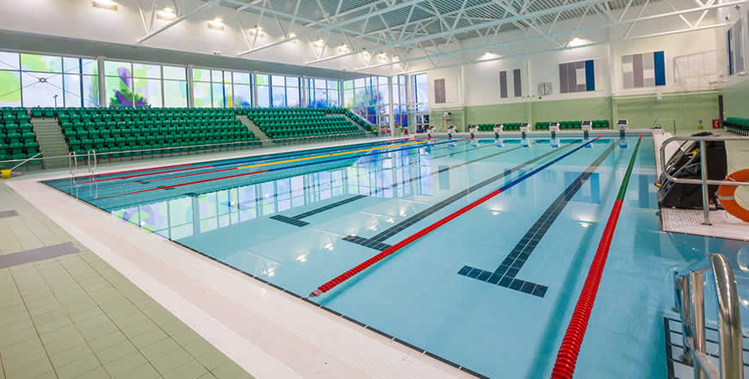
Swimming
Usually in Y2 PE curriculum, children take part in swimming over a term. We are unsure currently if this will be taking place.
You will receive letters nearer the time.
We recommend you visit Perdiswell Swimming Pool in advance to prepare your child for lessons.

Slide 19
The importance of E-safety
As children are growing up in this digital world it is important to be aware of how to keep your children safe online.
We are teaching e-safety as an integral part of our computing curriculum.
As teachers we think it is important that parents and carers are aware and are involved in the reinforcement of e-safety at home.

Slide 20
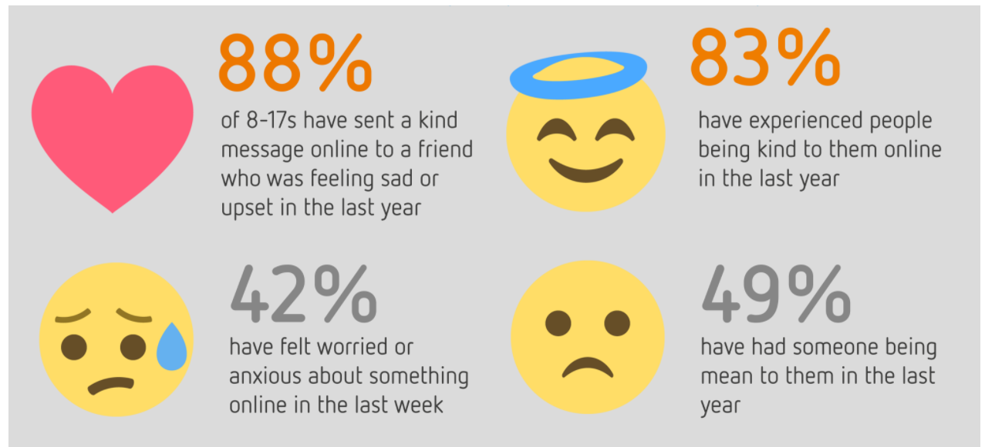
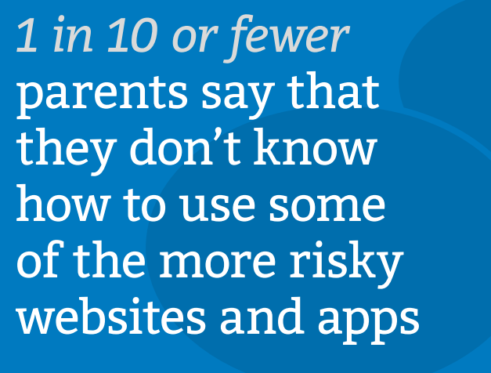
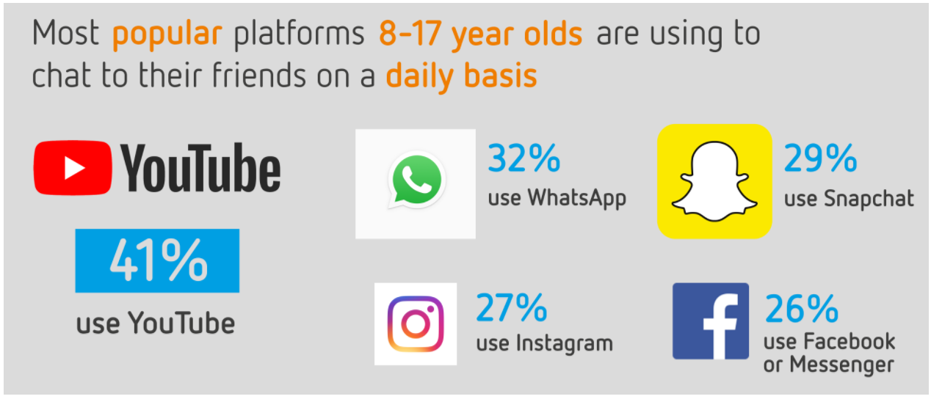
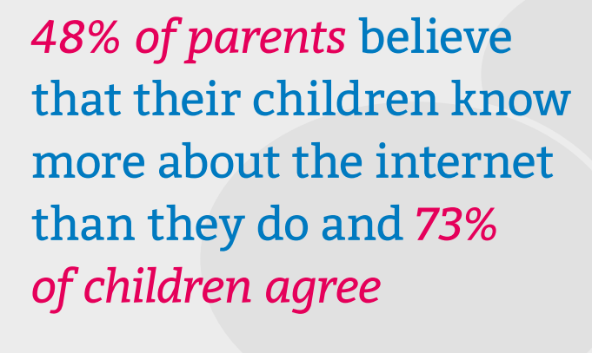

Slide 21
What can you do at home to keep your children safe?
Be aware of what your child is accessing online, monitor them at all times. Agree boundaries – manage their screen time, what can they go on?
Buy age appropriate games for Xbox and PlayStation. Be aware of the age restrictions for online games/apps.
Set up parental controls through your internet provider e.g. Sky. Internet matters has step by step instruction videos to help.
Ensure that they know what to do and who to tell if a stranger speaks to them online.
Know how to report issues online through CEOP.
https://www.ceop.police.uk/ceop-reporting/

Slide 22
Continued…
Please do not hesitate to contact your child’s class teacher or Mr Bowring, our online safety co-ordinator, should you have any concerns about your child’s online activity or a wider online safety issue. Alternatively, you can report a concern about the way someone has been communicating online through the Child Exploitation and Online Protection Command (CEOP) here: https://www.ceop.police.uk/ceop-reporting/
Apps which we feel parents should be aware of are
Youtube (inappropriate content)
Tiktok (inappropriate content/contact)
Messaging apps such as Whatsapp and Discord and social media (online bullying/speaking to strangers - contact)
Games such as - Roblox, fortnite (online bullying/speaking to strangers)

Slide 23
County Lines
As part of our school safeguarding approach, all of our staff are trained in and aware of the risks of County Lines. This term refers to the exploitation of young people by criminal gangs and has become more widespread in recent years. Criminals recruit children to traffic and sell illicit drugs, often through violence or manipulation. We would encourage you to be aware of the risks and dangers posed by county lines by reading some of these resources. There is also a resource on the National Online Safety app. Although victims of county lines tend to be older children, primary school aged children have been increasingly targeted as they are seen as less likely to be stopped by the police and potentially easier to manipulate.
https://www.youtube.com/watch?v=sgM6ju2Xi-0
https://www.safe4me.co.uk/portfolio/child-criminal-exploitation-county-lines/
https://www.suffolk.ac.uk/assets/images/about-us/Student-Support/County-Lines-Leaflet-Parents.pdf

Slide 24
Online Safety at St Joseph’s
Online safety is taught in class once per half term. We strive to promote a culture of responsibility in children, encouraging them to use technology safely and report anything which they think may be inappropriate or makes them feel uncomfortable to an adult at home or in school.
What to be aware of
Online Safety can be categorised in one of three ways using the three ‘Cs’. As teachers and parents we should always be aware of the risks to our children and take steps to protect them. Children of any age can be at risk of any of these categories if they are using a device which is connected to the internet.
​
Content: Being exposed to illegal, inappropriate or harmful content
Contact: Being subjected to harmful online interaction with other users; for example peer on peer abuse (online bullying), commercial advertising or adults posing as children for the purpose of harming children
Conduct: Personal behaviour online which increases the likelihood of or cause harm, such as sending and receiving inappropriate messages or online bullying

Slide 25
Online Safety at St Joseph’s
We have become a member of ‘National Online Safety’, a platform which offers regularly updated advice and guidance for parents and teachers on online safety issues facing children. We would strongly encourage you to take advantage of this by creating your own account.
To create your account, please follow https://nationalonlinesafety.com/enrol/st-joseph-s-catholic-primaryschool-wr4-9pg and complete your details. Alternatively, you can download the app and find our school using the postcode: WR4 9PG. When you’re set up, set ‘Parent/Carer’ as your user type. You can access National Online Safety online via any device, including smartphone app, by searching for ‘national online safety’ either on the Appstore or Google Play store
This resource can be used by you as a parent to keep abreast of any issues or concerns you have regarding online safety. The content is split into two main categories – ‘explainer videos’ and ‘guides’.
A video explaining how to use this resource can be found here: https://www.youtube.com/watch?v=QMHBa2exVKA

Slide 26
Key websites for information and advice
https://www.youtube.com/user/internetmatters
https://www.internetmatters.org/
https://www.nspcc.org.uk/preventing-abuse/keeping-children-safe/online-safety/e-safety-schools/
https://www.thinkuknow.co.uk/
Please read the advice handout

Slide 27
We hope you know a little more about Year Two now. Any questions please email – year3pearclassroom@st-josephs-pri.worcs.sch.uk This is Miss Malpass current email address ☺

